Slide 1
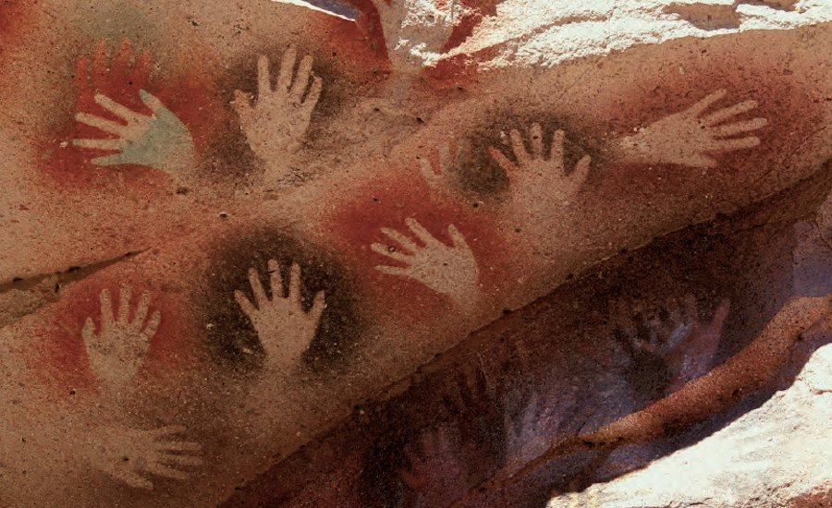
Year 4
Spring Term 2020
‘ Stoneage …Yabba Dabba Doo!’ ’
Visit to Mod Pizza
4DS 28th January
4B 4th February
As God’s children we will be learning about:
Living in communion with each other.
Life in the local Christian community
Celebrating growth to new life
As writers we will be learning about…
Persuasive writing
The text Iron Man by Ted Hughes
Assess the effectiveness of own and others’ writing
The love of reading during our whole school book week
As food technologists we will be…
Developing our cooking skills
As musicians we will be…
Studying the musical elements
Appraising and performing Blackbird
As athletes we will be learning to…
Develop our swimming skills
Participate in orienteering
Develop technique in dance/gymnastics
As mathematicians we will be studying…
The four operations
Time
Decimals
Angles
Fractions
Parallel and perpendicular lines
Symmetry
Shape and perimeter
Times tables!
Investigations
As computer technologists we will be…
Finding out how to be safe on the internet
Creating information pages
As historians we will be learning about…
The Stone, Bronze and Iron Ages
How our early ancestors adapted and learnt new skills in order to survive
Don’t forget our Stone Age Day!
Thursday 13th February
As artists we will be…
Creating cave paintings
Making clay pots

